Slide 1
Algorithms and Data Structures (CIS1002-N)
Week 4: Linked-Lists
Module Leader: Dr Annalisa Occhipinti
Email: A.Occhipinti@tees.ac.uk

Slide 2
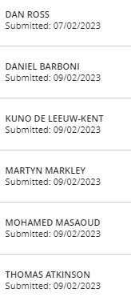

Week 3 – BB Quiz
Well done to:

Slide 3
Recap Questions
What is the time complexity of Bubble Sort, Insertion Sort and Selection Sort?
Justify your answer.
You should think of the number of comparisons that each algorithm requires

Slide 4
Sorting algorithms
We are given n records to sort.
There are a number of simple sorting algorithms whose time performance is quadratic O(n²):
Bubble sort
Cocktail Shaker sort
Selection sort
Insertion sort
The faster comparison based algorithm are O(n log n)
Mergesort
Quicksort

Slide 5
Bubble Sort Time Analysis
In O-notation, what is the running time for n items?
Steps of algorithm:
for i = 0 to n-1
starting from left, compare each cell with its immediate neighbour
if elements out of order, swap until largest at right-end of array
if no elements swapped in this pass through array, done.
otherwise, decrease size of unsorted array by 1 and continue
Bubble sort analysis: O(n²)
Outer loop O(n)
Inner loop O(n)
Notes:
The brute force approach is to pass through the array until no swaps are performed, indicating that the array is sorted.
An improvement is obtained if we scan over 0: i – 1 if i is the outer loop variable (i.e. reducing the array by one each pass). This produces a twofold gain of speed.

Slide 6
Selection Sort Time Analysis
In O-notation, what is the running time for n items?
Steps of algorithm:
for i = 0 to n-1
find smallest key in unsorted part of array
swap smallest item to front of unsorted array
decrease size of unsorted array by 1 and repeat
Selection sort analysis: O(n²)
O(n)
O(n)

Slide 7
Insertion Sort Time Analysis
In O-notation, what is the running time for n items?
Steps of algorithm:
for i = 1 to n-1
take next key from unsorted part of array
insert in appropriate location in sorted part of array:
for j = i down to 0,
shift sorted elements to the right if key > key[i]
increase size of sorted array by 1
Insertion sort analysis: O(n²)
Outer loop:
O(n)
Inner loop:
O(n)

Slide 8
Analysis of Sorting Algorithms - Summary
Selection sort, Insertion sort, and Bubble sort all have a worst-case time of O(n²), making them impractical for large arrays.
But they are easy to program, easy to debug.
Insertion Sort also has good performance when the array is nearly sorted to begin with.
But more sophisticated sorting algorithms are needed when good performance is needed in all cases for large arrays.
Notes:
A quick summary of these algorithms' timing properties.

Slide 9
Schedule
Learning Outcomes
PERSONAL AND TRANSFERABLE SKILLS
Solve well-defined algorithmic problems using established computer programming concepts and principles.
RESEARCH, KNOWLEDGE AND COGNITIVE SKILLS:
Identify trends, patterns and relationships in the way various data structures are built and operate on data
Week | Lecture (1hour) – Lab Session (2hours)
Week 1 | Introduction to Algorithms and Data-Structures – Array ADT
Week 2 | Sorting : Bubble sort, Cocktail Shaker sort
Week 3 | Sorting : Selection sort and Insertion sort
Week 4 | Singular Linked-lists | ICA Briefing – Programming Tasks
Week 5 | Doubly Linked-lists
Week 6 | Circular Linked-lists
Week 7 | Stacks
Week 8 | Queues
Week 9 | Recursion
Week 10 | Recursion
Week 11 | Trees and balanced trees
Week 12 | Merge Sort and Quick Sort
Learning Outcomes (DEGREE APPRENTICESHIP – KNOWLEDGE SKILLS AND BEHAVIOURS)
Core behavioural skills
C24: Apply analytical and critical thinking skills to Technology Solutions development
Specialism Outcomes
SE5: Test code to ensure that the functional and non-functional requirements have been met.
SE3: Produce high quality code with sound syntax in at least one language following best practices and standards.
Note: The schedule may be adjusted based on class progress.

Slide 10
Today…
Recap on the concept of arrays as Abstract-data types
Linked-lists

Slide 11


Arrays as ADT
We love Arrays because… | But they can let us down…

Slide 12
Arrays as ADT
We love Arrays because… | But they can let us down…
Arrays are generally space efficient when the user knows in advance approximately how large the set of components will evolve to. No wasted space for an individual component. Extremely efficient when frequent access is required. As the data is tightly packed together, since it is stored contiguously, the Operating system transfers vast chunks of it into cache memory (cache memory is the fastest memory available to the computer) | Not flexible: the length of the array is fixed when the array is constructed (you could declare arrays much larger than we anticipate we need, but it would be a waste of memory) Attempting to write past the end of the array – underflow/overflow Sparse arrays (with lots of zeroes or empty spaces) will exaggerate the wastage problem. Inserting/Deleting an element or merging two arrays can be time consuming if you need to keep the array “packed”.

Slide 13
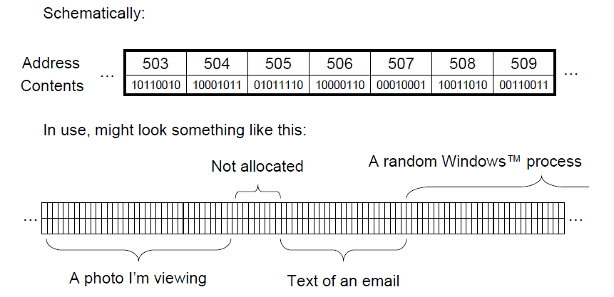
Physical Memory

Slide 14
Insertion (1) - Recap
Insert element 12 at index position 5
12
0 1 2 3 4 5 6 7 8 9
12
3
6
23
80
45
18
10
?
?

Slide 15
Insertion (2) - Recap
Insert element 12 at index position 5
12
0 1 2 3 4 5 6 7 8 9
12
3
6
23
80
45
18
?
10
?

Slide 16
Insertion (3) - Recap
Insert element 12 at index position 5
12
0 1 2 3 4 5 6 7 8 9
12
3
6
23
80
45
?
18
10
?

Slide 17
Insertion (4) - Recap
Insert element 12 at index position 5
12
0 1 2 3 4 5 6 7 8 9
12
3
6
23
80
?
45
18
10
?

Slide 18
Insertion (5) - Recap
Insert element 12 at index position 5
?
0 1 2 3 4 5 6 7 8 9
12
3
6
23
80
12
45
18
10
?

Slide 19
Deletion (1) - Recap
Delete element at index position 4
0 1 2 3 4 5 6 7 8 9
12
3
6
23
80
12
45
18
10
?

Slide 20
Deletion (2) - Recap
Delete element at index position 4
0 1 2 3 4 5 6 7 8 9
12
3
6
23
?
12
45
18
10
?

Slide 21
Deletion (3) - Recap
Delete element at index position 4
0 1 2 3 4 5 6 7 8 9
12
3
6
23
12
12
45
18
10
?

Slide 22
Deletion (4) - Recap
Delete element at index position 4
0 1 2 3 4 5 6 7 8 9
12
3
6
23
12
45
45
18
10
?

Slide 23
Deletion (5) - Recap
Delete element at index position 4
0 1 2 3 4 5 6 7 8 9
12
3
6
23
12
45
18
18
10
?

Slide 24
Deletion (6) - Recap
Delete element at index position 4
0 1 2 3 4 5 6 7 8 9
12
3
6
23
12
45
18
10
10
?
Index position 8 will still contain previous value – delete if important

Slide 25
Arrays to Linked-lists
Arrays are not efficient when dealing with problems where we need to:
Join two arrays.
Insert an element at an arbitrary location.
Delete an element from an arbitrary location.
Another data structure called linked-list can be used in programs.

Slide 26
Linked Lists: an alternative to Arrays
data
next
data
next
data
next
data
next
data
null
head

Slide 27
Abstract Data Type VS Data Structure
Abstract Data Type:
a collection of data.
a set of operations on that data (Inserting, deleting, retrieving, searching or sorting data)
Underlying implementation is invisible to the procedures that use it
Abstract: concerned only with abstract operations supported
Data Structure:
the construct within a programming language that stores this collection of data.
accessed or modified through the implemented operations/methods
Concrete: concerned with addresses and location in physical memory.

Slide 28
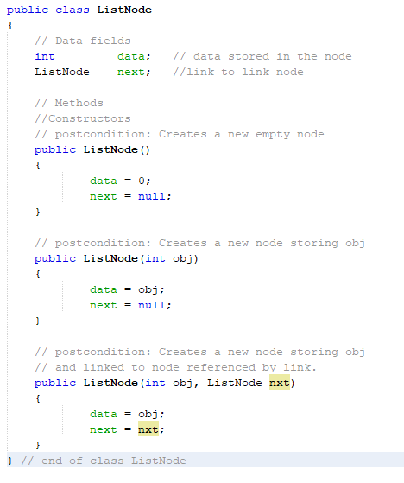
Linked-Lists
Definition:
Collection of components, called nodes.
Each node in a linked-list has 2 components:
1 to store the relevant information: data
1 to store the address of the next node: next
Each node (except the last node) contains the address of the next node.
data
next
data
next
data
next
data
next
data
null
head

Slide 29
Linked-lists
A linked-list is a set of data items connected by link fields (reference-variables or pointers) like a chain.
Each node contains:
a) an info (data) part and
b) a link (reference-variable/pointer/next) part.
Nodes do not have to follow each other physically in memory.
data
next

Slide 30
Linked-Lists (1)
data
next
data
next
data
next
data
next
data
null
head
Advantage: Nodes do not have to follow each other physically in memory.
Example (as is in memory):
1500
1532
1564
1596
1628
12
1532
54
1564
3
1596
67
1628
32
head

Slide 31
Linked-Lists
Address of the first node in the list is stored in a separate location: head which represents our reference point to the list.
data
next
data
next
data
next
data
next
data
null
head

Slide 32
Pointer / Reference-Variable
If we declare a new node variable current
and current = head;
we copy the value of head into current, i.e. current points to the same memory location as head
1500
1532
1564
1596
1628
12
1532
54
1564
3
1596
67
1628
32
current
head

Slide 33
Pointer / Reference-Variable
A node contains a fixed pointer / reference-variable to the next node in the list to serve as link,
we will also make use of free-ranging or traveling pointers / reference-variables to travel up and down the list or simply to mark a point in the list.
head
1500
1532
1564
1596
1628
1500
12
1532
54
1564
3
1596
67
1628
32
1564
current

Slide 34
Traversing
What does the following statement do?
current = current.next;
Use such a statement to advance a pointer / reference-variable to the next node:
1500
1532
1564
1596
1628
12
1532
54
1564
3
1596
67
1628
32
head
1500
current
posn to start with
1532
current
posn
after the
statement

Slide 35
Traversing - Algorithm
current = head;
while (current != null)
{
print(current.data + “ “);
current = current.next;
}
1500
1532
1564
1596
1628
head
12
1532
54
1564
3
1596
67
1628
32
1500
current
1532
current
1564
current
1596
current
1628
current
Output to console?
12 54 3 67 32

Slide 36
Insertion (1)
Insert a new node (17) after node pointed to by current
1500
1532
1564
1596
1628
12
1532
54
1564
3
1596
67
1628
32
head
current

Slide 37
Insertion (2)
1500
1532
1564
1596
1628
1500
12
1532
54
1564
3
1596
67
1628
32
head
current
Create new node (with data value and address):
newNode
1800
1800
17

Slide 38
Insertion (3)
1500
1532
1564
1596
1628
1500
12
1532
54
1564
3
1596
67
1628
32
head
current
1800
1800
17
1532
newNode
newNode should point at next element after current.

Slide 39
Insertion (4)
1500
1532
1564
1596
1628
1500
12
1800
54
1564
3
1596
67
1628
32
head
head
current
newNode
newNode
1800
1800
17
12
1532
1800
1532
1800
Current node link\pointer changed to point at newNode

Slide 40
Insertion – Final result
head
1500
1532
1564
1596
1628
1500
12
1800
54
1564
3
1596
67
1628
32
1800
17
1532
Done!!!

Slide 41
Insertion – Algorithm?
1500
1532
1564
1596
1628
1500
12
1532
54
1564
3
1596
67
1628
32
head
current
newNode
1800
1800
17

Slide 42
Insertion - Algorithm
Create
newNode = new NodeType();
Point to next
newNode.next = current.next;
Link to previous
current.next = newNode;
newNode
1800
1800
17
newNode
1800
1800
17
1532
1800
17
1532
1500
1532
1564
1596
1628
1500
12
1532
54
1564
3
1596
67
1628
32
head
current

Slide 43
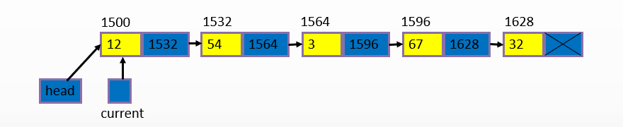
Warning – Order is crucial

Slide 44
Warning – Order is crucial
Create
newNode = new NodeType();
2. Point to next
current.next = newNode;
3. Link to previous
newNode.next = current.next;
newNode
1800
1800
17
newNode
1800
1800
17
1800
17
1800

Slide 45
Would this be OK?
newNode = new NodeType();
current.next = newNode;
newNode.next = current.next;

Slide 46
Deletion (1)
Point (current) at node before the one to be deleted
head
1500
1532
1564
1596
1628
1500
12
1532
54
1564
3
1596
67
1628
32
current
toDelete

Slide 47
Deletion (1)
head
1500
1532
1564
1596
1628
1500
12
1532
54
1564
3
1596
67
1628
32
current
toDelete
Point (current) at node before the one to be deleted

Slide 48
Deletion (2)
head
1532
1532
1564
1564
1596
1500
1596
1628
1500
12
1532
54
1564
3
67
32
1596
1596
1628
current
toDelete
Change the link to skip the node marked for deletion.
Delete the isolated node. How ?

Slide 49
Deletion (3)
1532
1532
1596
1500
1596
1628
1500
12
1532
54
1596
67
1628
32
current
Delete the isolated node. How ?

Slide 50
Deletion – Final result
head
1500
1532
1596
1628
1500
12
1532
54
1596
67
1628
32

Slide 51
Deletion – Algorithm?
head
1500
1532
1564
1596
1628
1500
12
1532
54
1564
3
1596
67
1628
32
current
toDelete

Slide 52
Deletion - Algorithm
toDelete = current.next;
current.next = toDelete.next;
toDelete.next = null;
toDelete = null;
1532
1532
1564
1564
1596
1500
1596
1628
1500
12
1532
54
1564
3
67
32
1596
1596
1628
current
toDelete

Slide 53
Deletion – task completed
1532
1532
1564
1564
1596
1500
1596
1628
1500
12
1532
54
1596
3
67
1628
32
current
toDelete
Unlink the marked node by making it linking to null.
Then set toDelete to null.
The Garbage Collector will return the isolated node to the system heap and the corresponding amount of memory is made available to the programmer again.

Slide 54
Linked-Lists VS Arrays
Linked-Lists | Arrays
More complex to implementation and manage | Easy to implement
Dynamic: a linked-list can easily grow and shrink in size. We don’t need to know how many nodes will be in the list. They are created in memory as needed. As a result linked-lists normally start empty | Not-flexible: The size of an array is fixed at compilation time.
Easy and fast insertion and deletion With a linked-list, no need to move other nodes. Only need to reset some reference-variables / pointers. | Insertion and deletion are time-consuming To insert or delete an element in an array, we need to copy to temporary variables to make room for new elements or close the gap caused by deleted elements.

Slide 55

Quizizz!

Slide 56
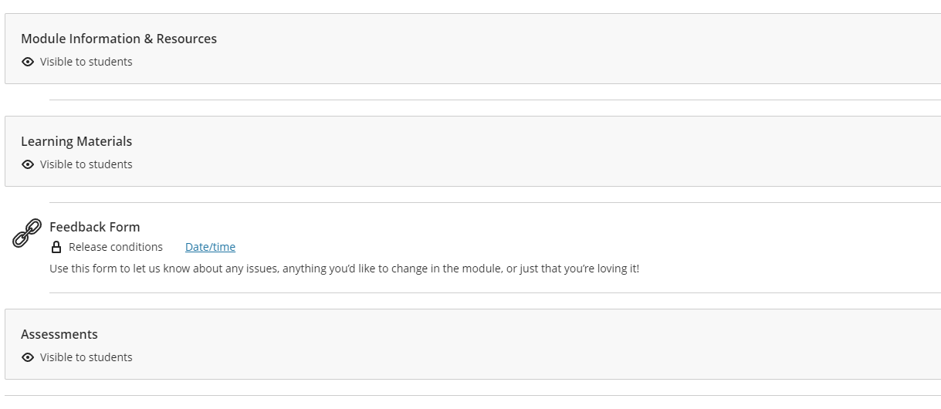

Slide 57
Questions?

Slide 58
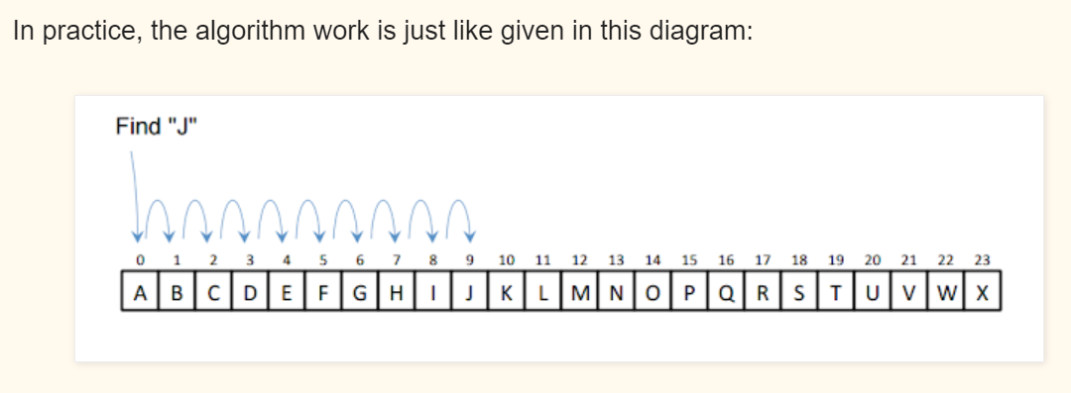
Homework
Implement the Linear search Algorithm in Java.
You should go through all elements in the array using a for loop and compare each element with the one you want to search. When an element matches you return true/false.
Use the method signature below:
linearSearch(int[] a, int obj) // a is the array and obj is the elements that you want to search.

